Slide 1





Winnetka Road to Willow Road
Happ Road Corridor Study
Village of Northfield
Steering Committee Meeting #3
February 23, 2017

Slide 2
Meeting Agenda
Updated Project Goals Statement
Further Developed Improvement Alternatives
  Locations to be Discussed
    North Section Alternatives (Downtown)
      Standard Intersection vs. Roundabout
    Middle Section Alternatives (Happ Road Park Area)
      Standard Ped Crossing vs. Raised Refuge
    South Section Alternatives (Winnetka Intersection)
      Four-Way Stop vs. Traffic Signal
  Items to be Discussed for Each Section
    Crash Data
    Crash Analysis
    Existing Conditions Analysis
    Traffic Data and Analysis
    Refined Improvement Alternatives
Next Steps

Slide 3
Happ Road
Updated Goal Statement
Improve the Happ Road Corridor by:
Improving safety for all users
Simplifying vehicular movements at intersections
Minimizing vehicular points of conflict
Increasing awareness of pedestrians
Enhancing bicycle accommodations within the corridor, and
Creating a central place, supportive of local businesses and community gathering and walkable access.

Slide 4
North Section (Downtown)
Happ Road Phase I Study
Village of Northfield

Slide 5
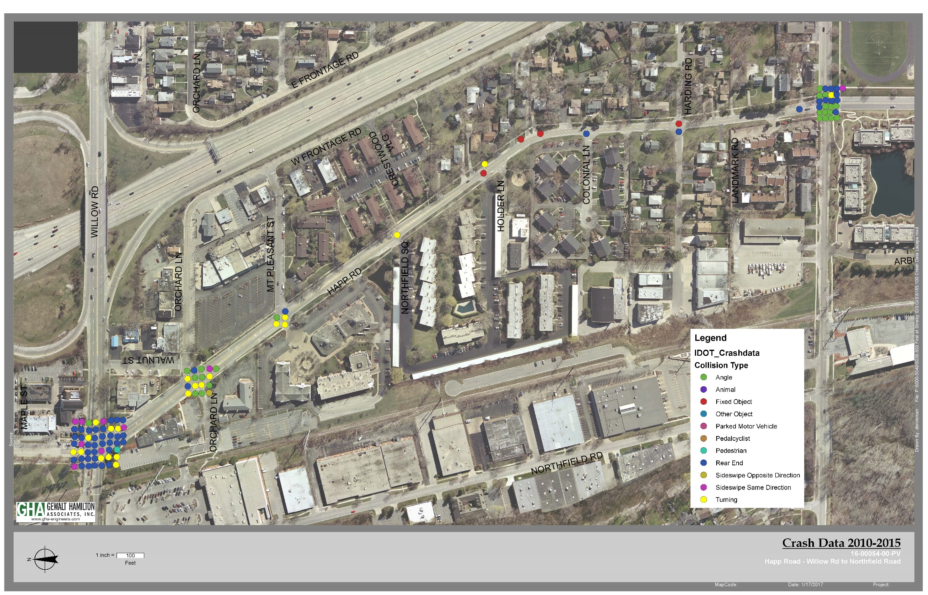
Accident Location Map

Slide 6
Accident Analysis
Orchard Lane Intersection:
Angle 8
Turning 5
Rear-end 2
Sideswipe 2
TOTAL: 17
Rear-end and Sideswipe Crashes tend to be less severe (i.e., fender-benders). The accident data indicates that congestion is not a major factor at this intersection.
Angle and Turning Crashes tend to result in more severe injuries. High rate of incidence indicates confusion with turn movements and the need to better delineate turning movements.

Slide 7
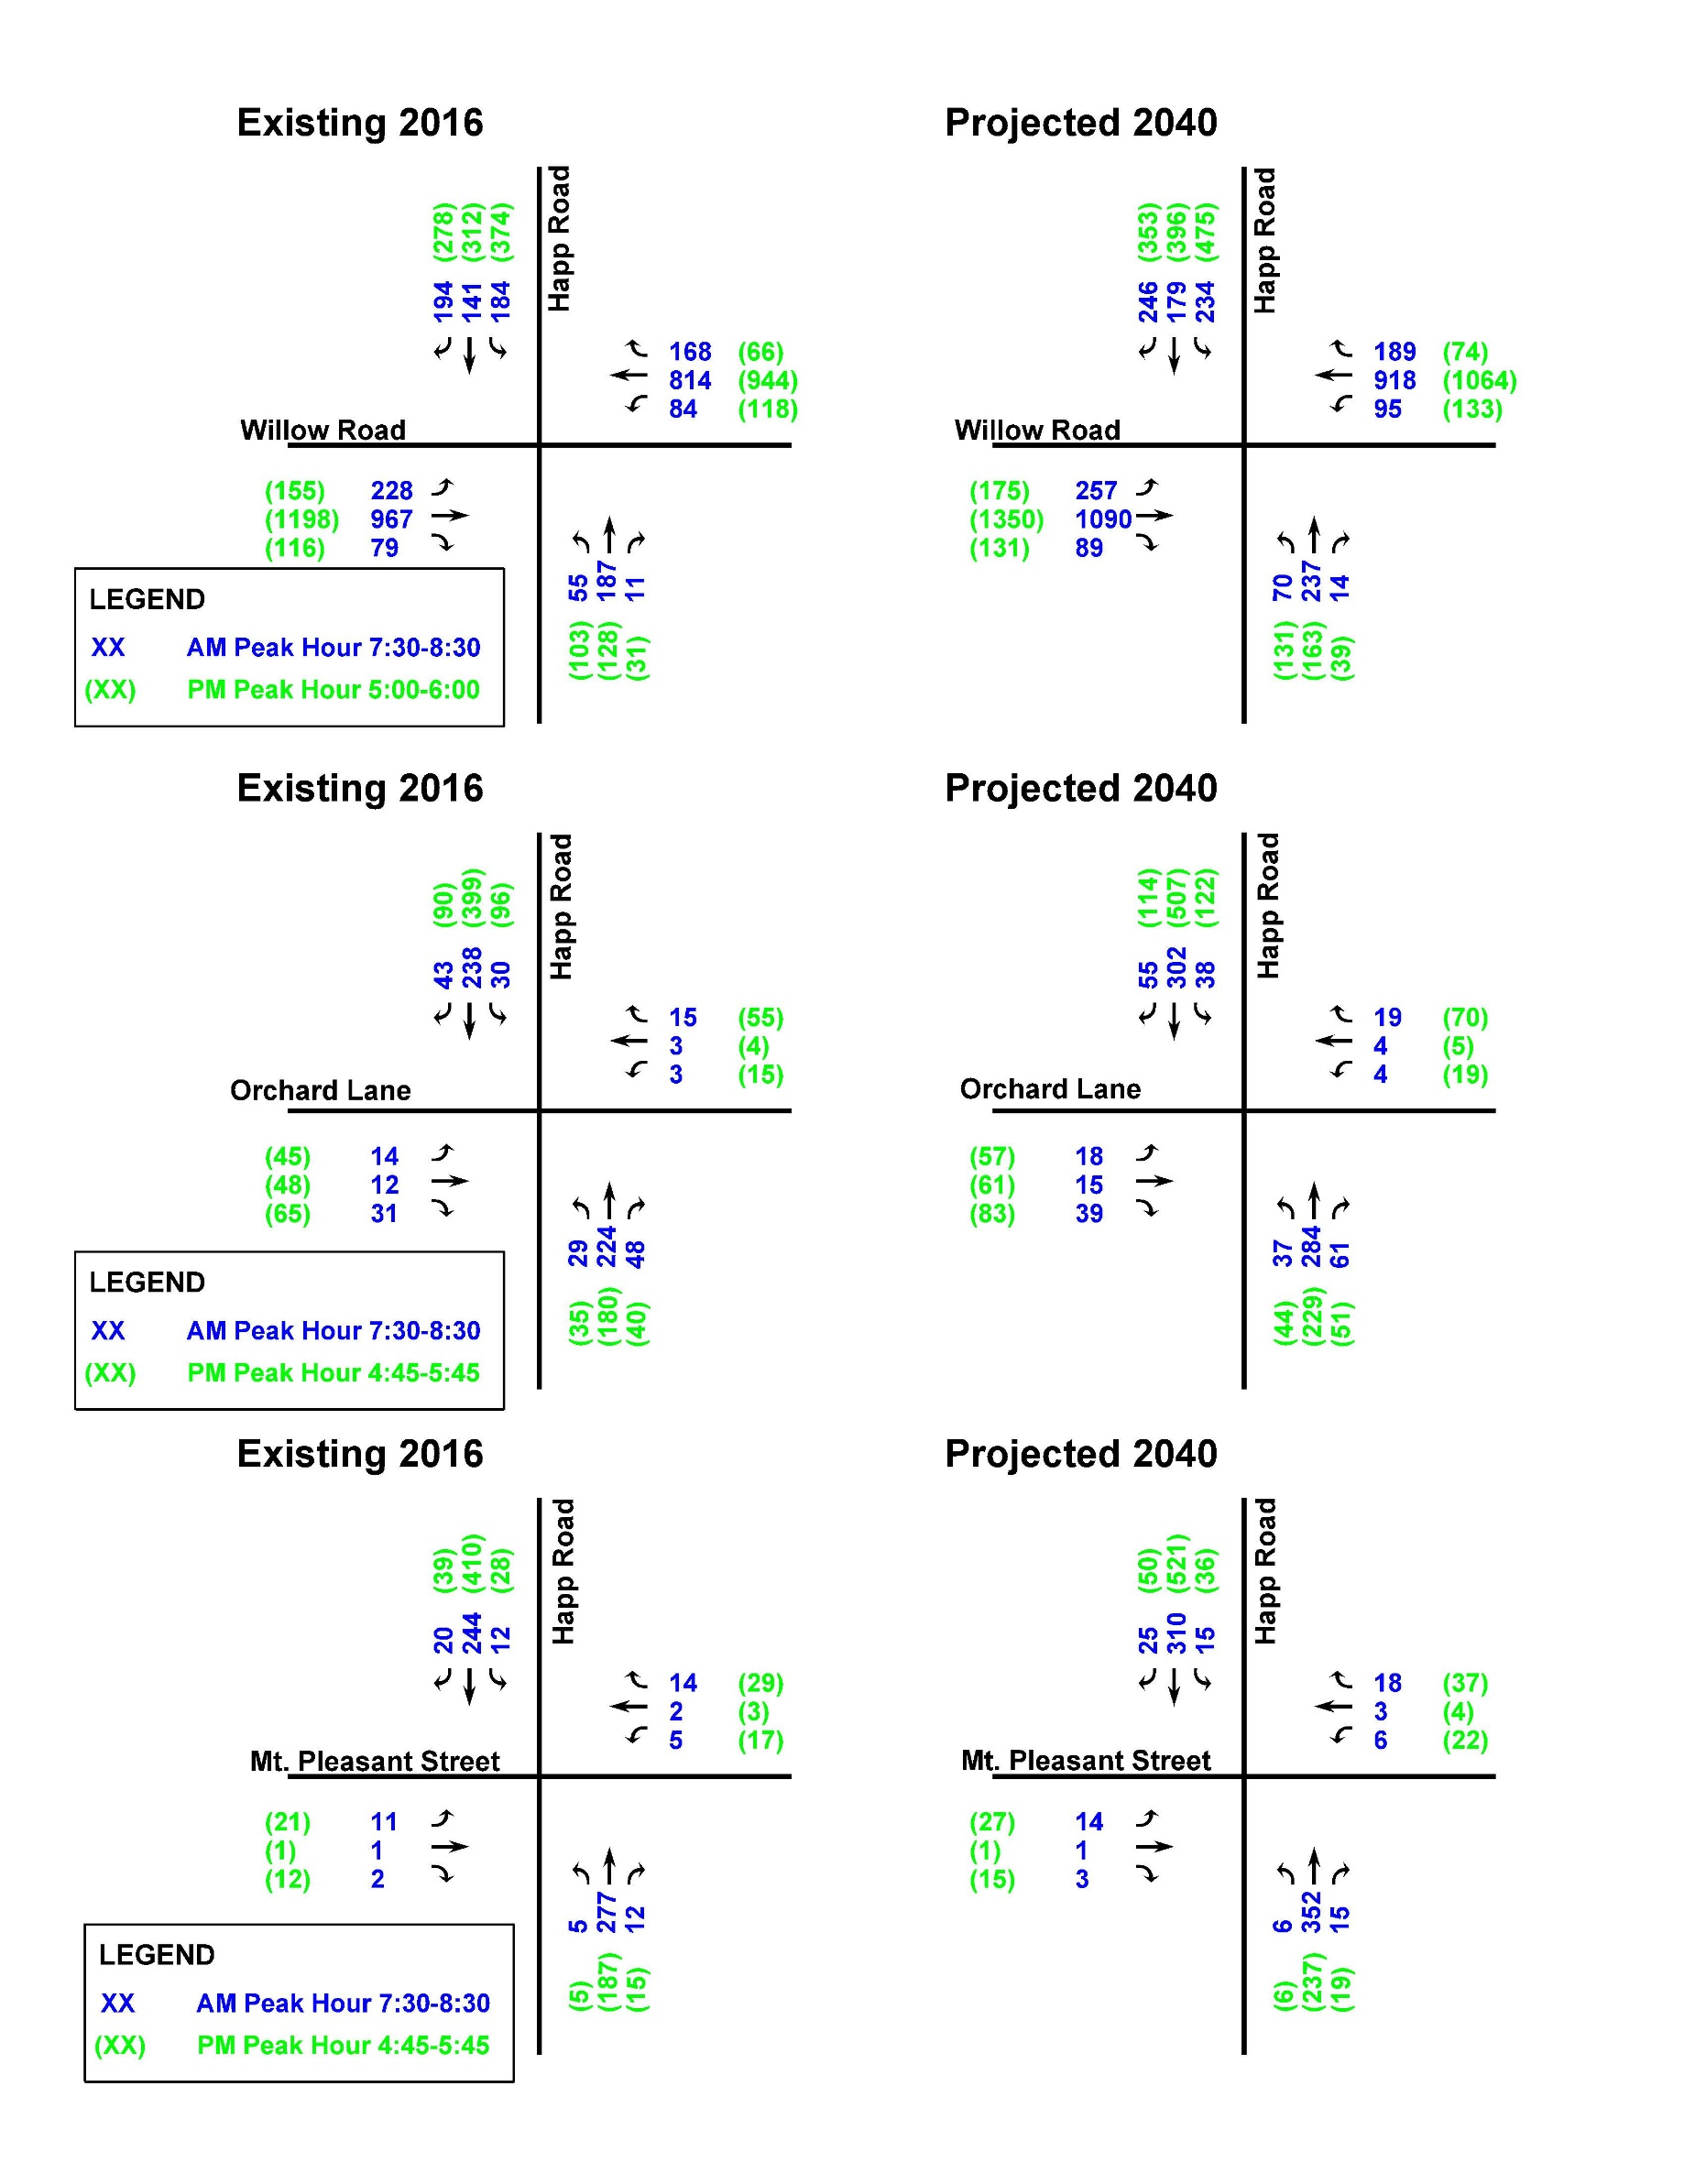
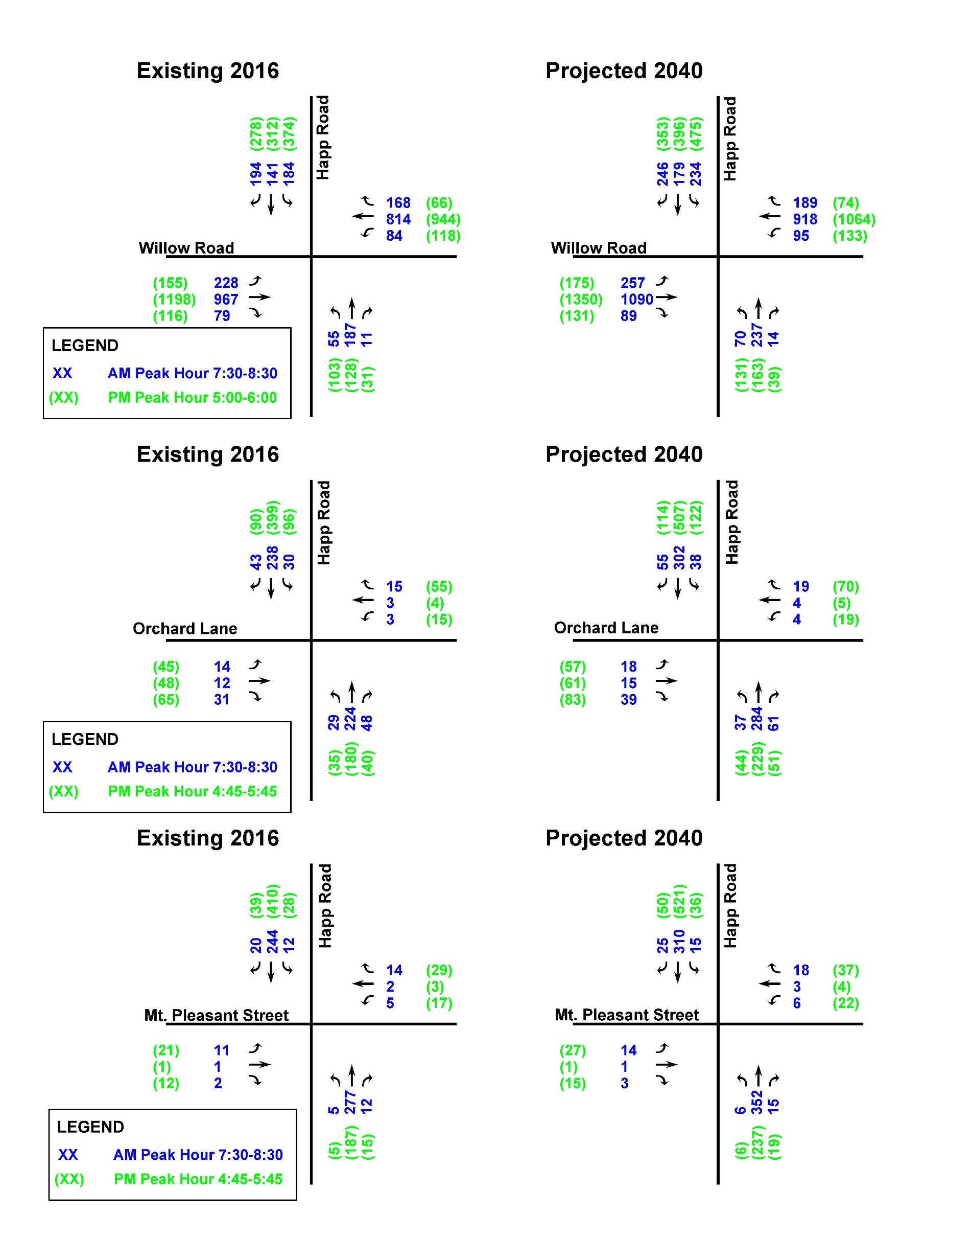
Orchard Lane Intersection
Existing Traffic
2016
Projected Traffic
2040

Slide 8
Mt. Pleasant Street Intersection
Existing Traffic
2016
Projected Traffic
2040

Slide 9
Traffic Analysis
Level-of-Service (LOS) – Unsignalized Intersections
(stopped movements and unstopped left turns)
Ave. Delay (seconds) LOS
< 10 A
10-15 B
15-25 C
25-35 D
35-50 E
> 50 F

Slide 10
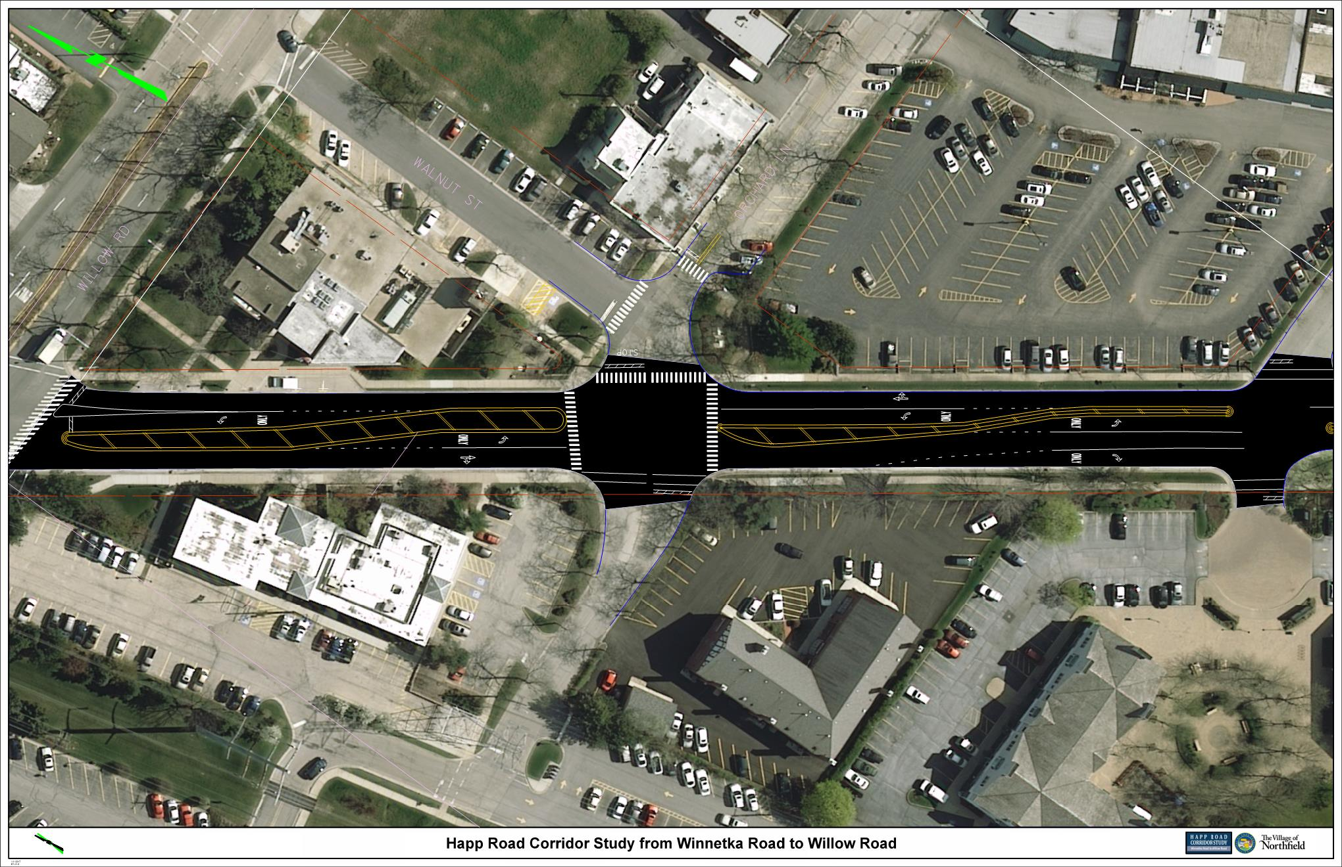
Existing Conditions
Orchard Lane
2016 Traffic Analysis
AM LOS - B (EB) / B (WB)
PM LOS - D (EB) / C (WB)
Mt. Pleasant Street
2016 Traffic Analysis
AM LOS - B (EB) / B (WB)
PM LOS - C (EB) / B (WB)
Orchard Lane
Walnut Street
Mt. Pleasant
Orchard Lane
2040 Traffic Analysis
AM LOS - C (EB) / B (WB)
PM LOS - F (EB) / D (WB)
Mt. Pleasant Street
2016 Traffic Analysis
AM LOS - C (EB) / B (WB)
PM LOS - C (EB) / C (WB)

Slide 11
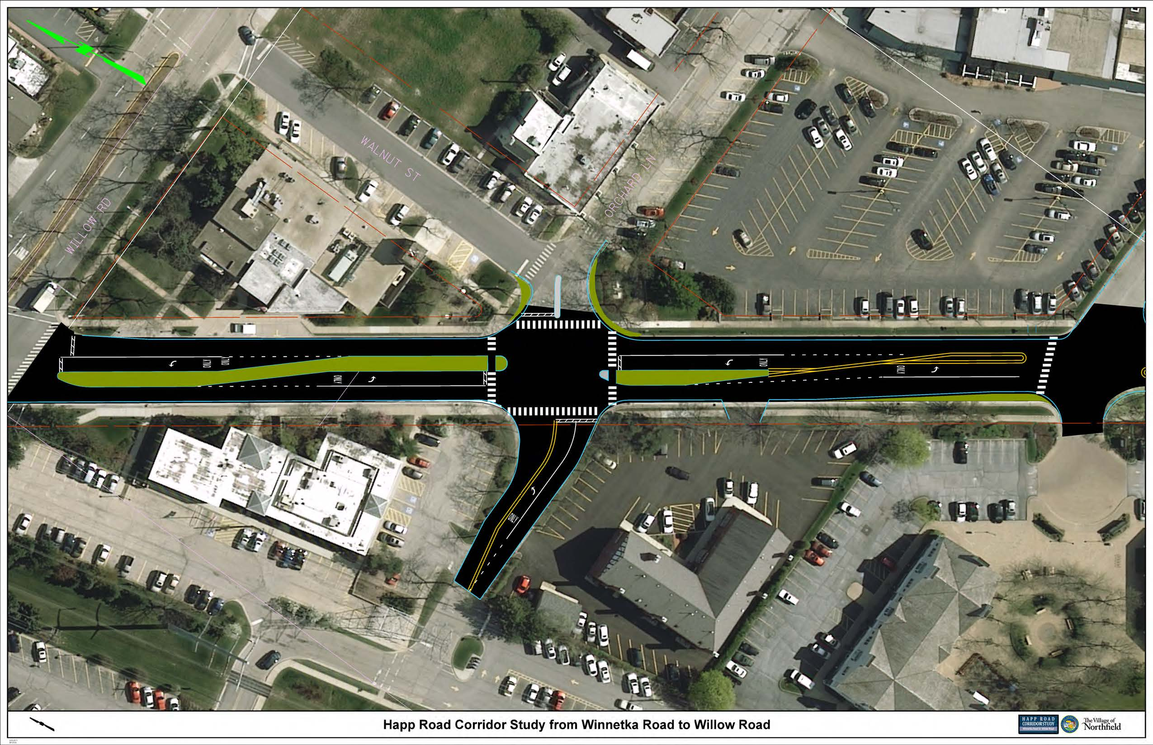
Happ Road – Orchard Lane Intersection
Alternative – Standard Intersection
Orchard Lane
2016 Traffic Analysis
AM LOS - B (EB) / B (WB)
PM LOS - C (EB) / C (WB)
Mt. Pleasant Street
2016 Traffic Analysis
AM LOS - B (EB) / B (WB)
PM LOS - C (EB) / B (WB)
LOS
Orchard Lane
Walnut Street
Mt. Pleasant
Orchard Lane
2040 Traffic Analysis
AM LOS - C (EB) / B (WB)
PM LOS - E (EB) / D (WB)
Mt. Pleasant Street
2040 Traffic Analysis
AM LOS - C (EB) / B (WB)
PM LOS - C (EB) / C (WB)
Notes:
Beginning with Initial Round 1 Activities
Part 1: Identify issues and concerns
Part 2: Defining goals and objectives

Slide 12
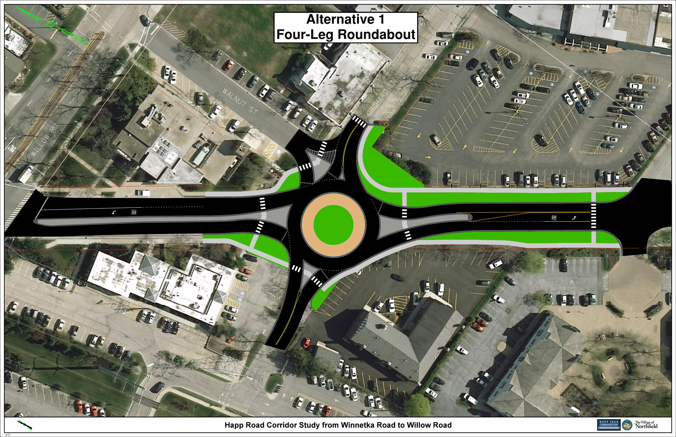
Happ Road – Orchard Lane Intersection
Standard Intersection vs. Roundabout
vs.
Notes:
Beginning with Initial Round 1 Activities
Part 1: Identify issues and concerns
Part 2: Defining goals and objectives

Slide 13
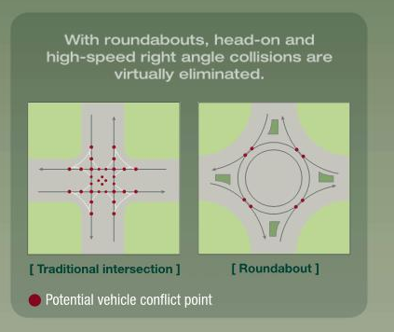
Roundabouts –
Reduced Vehicular Conflict Points
Standard Intersection =
32 Conflict Points
Roundabout =
8 Conflict Points

Slide 14
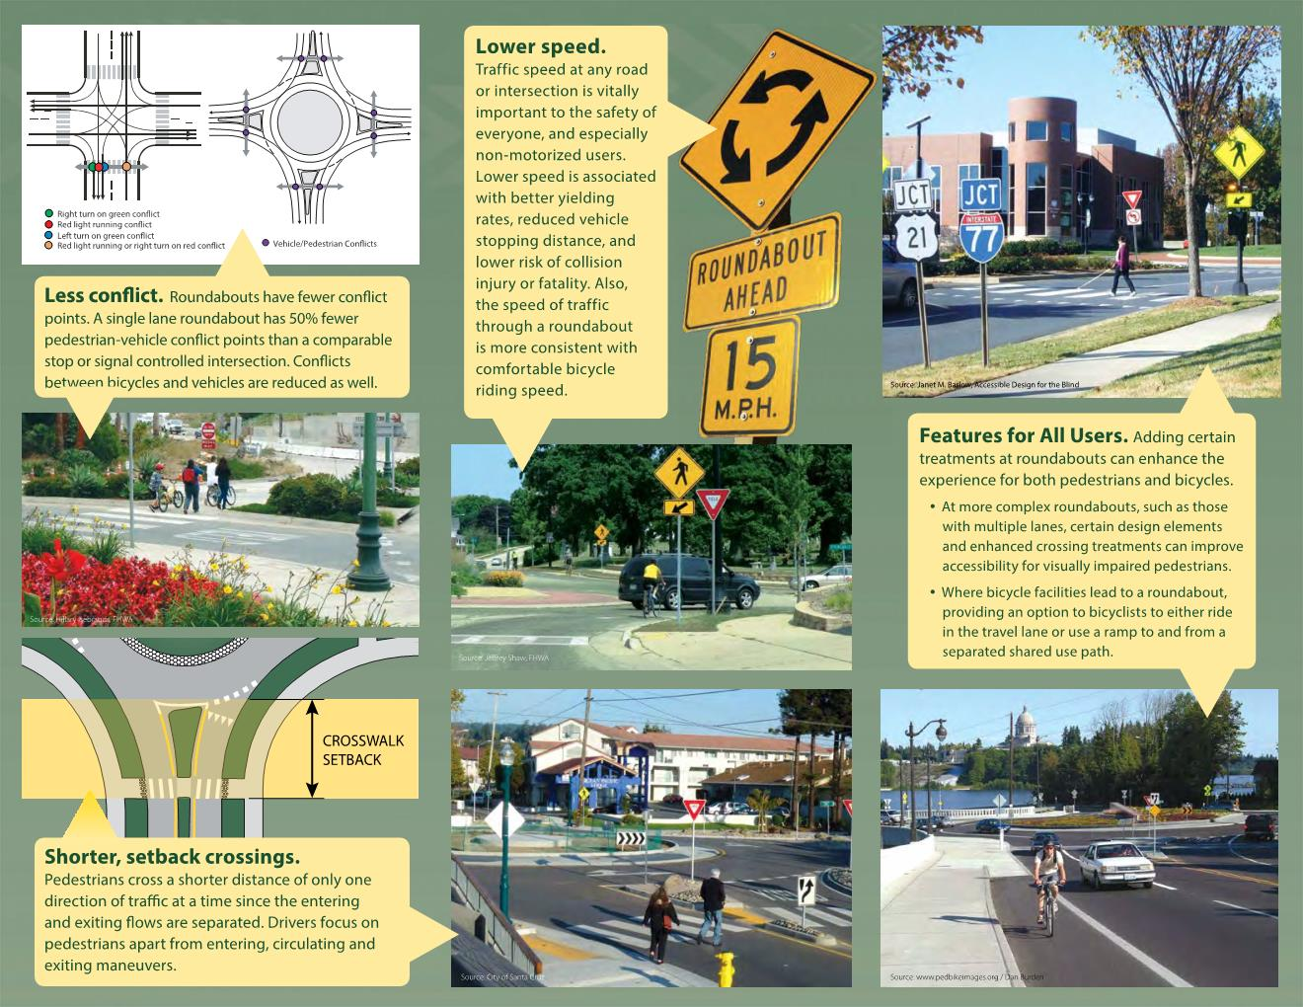
Roundabouts
Increased Pedestrian Safety
Separates Pedestrians from the Circular Movements
Shorter Crossing Distances

Slide 15
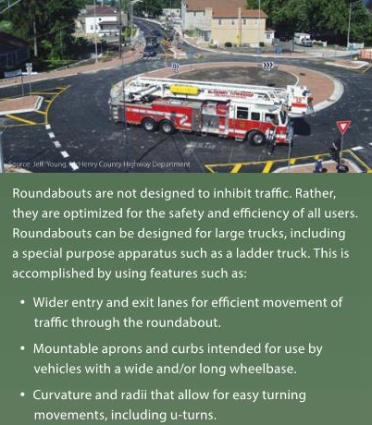
Roundabouts and Emergency Service

Slide 16
Roundabout Actual Safety Data
Below is the data from the Lake County Division of Transportation for the first 3 roundabouts that they built:
Number of Crashes at Roundabout Locations
Location | 2007-2010 (4 yrs) | 2012-2014 (3 yrs)
Hunt Club & Millburn | 24 | 10
Hunt Club & Wadsworth | 11 | 8
Riverwoods & Everett | 19 | 6
Hunt Club & Millburn and Hunt Club & Wadsworth were 3-way stop controlled and Riverwoods & Everett was 4-way stop controlled prior to the roundabout installation. In all cases, the severity of the crashes has lessened with the roundabouts in place.

Slide 17
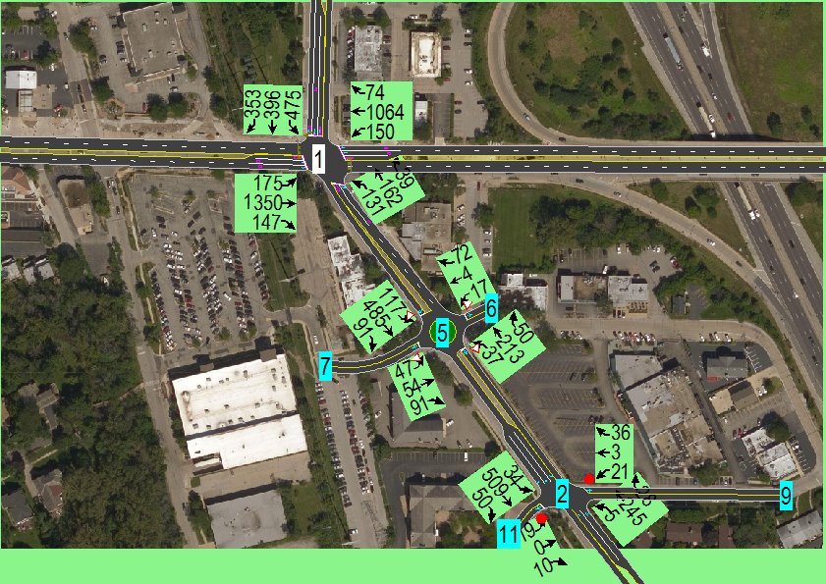
Happ Road – Orchard Lane Intersection
Alternative – Roundabout (Synchro)
Notes:
Beginning with Initial Round 1 Activities
Part 1: Identify issues and concerns
Part 2: Defining goals and objectives

Slide 18
Happ Road – Orchard Lane Intersection
Alternative – Roundabout #1 – 4 Leg
2016 Traffic Analysis
AM LOS - A (EB) / A (WB)
PM LOS - A (EB) / A (WB)
Orchard Lane
Walnut Street
Mt. Pleasant
2040 Traffic Analysis
AM LOS - A (EB) / A (WB)
PM LOS - B (EB) / A (WB)
Notes:
Beginning with Initial Round 1 Activities
Part 1: Identify issues and concerns
Part 2: Defining goals and objectives

Slide 19
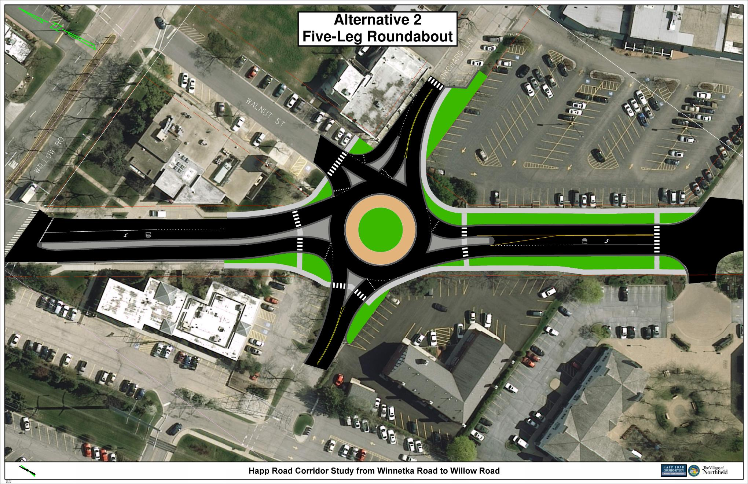
Happ Road – Orchard Lane Intersection
Alternative – Roundabout #2 – 5 Leg
2016 Traffic Analysis
AM LOS - A (EB) / A (WB)
PM LOS - A (EB) / A (WB)
Orchard Lane
Walnut Street
Mt. Pleasant
2040 Traffic Analysis
AM LOS - A (EB) / A (WB)
PM LOS - B (EB) / A (WB)
Notes:
Beginning with Initial Round 1 Activities
Part 1: Identify issues and concerns
Part 2: Defining goals and objectives

Slide 20
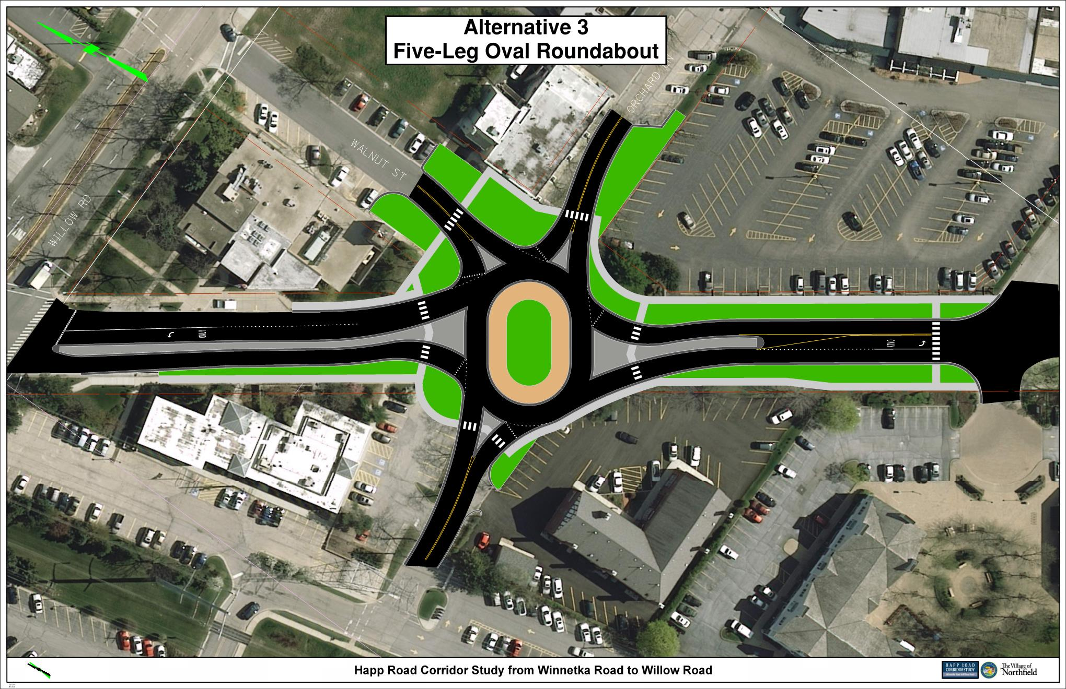
Happ Road – Orchard Lane Intersection
Alternative – Roundabout #3 – 5 Leg Oval
2016 Traffic Analysis
AM LOS - A (EB) / A (WB)
PM LOS - A (EB) / A (WB)
Orchard Lane
Walnut Street
Mt. Pleasant
2040 Traffic Analysis
AM LOS - A (EB) / A (WB)
PM LOS - B (EB) / A (WB)
Notes:
Beginning with Initial Round 1 Activities
Part 1: Identify issues and concerns
Part 2: Defining goals and objectives

Slide 21
Summary of Alternatives
Alternatives | Pros | Cons
Standard Intersection | Meets driver expectations | Poor LOS in 2040
 | Maintains current traffic turning movements | Pedestrians have to cross at least 2 lanes of traffic at a time
 | Maintains uninterrupted traffic flow on Happ Road
 | Small footprint
Roundabout | Improved LOS | Drivers not accustomed
 | Reduced vehicle conflict points | Requires drivers on Happ to slow down through the roundabout
 | Reduced crash severity (per Insurance Institute for Highway Safety – 40% decrease in all accidents and 90% decrease in fatal accidents) | Requires a larger footprint
 | Increased pedestrian safety | No emergency vehicle priority
 | Reduce emissions and improved fuel economy by reducing idling | Restricts/Eliminates private driveway located on west side of Happ Road (South of Orchard)
 | Allows for Aesthetic enhancements

Slide 22
    Middle Section
    (Happ Road Park Area)
Happ Road Phase I Study
Village of Northfield

Slide 23
Accident Location Map

Slide 24
Accident Analysis
Middle (Happ Road) Section:
Fixed Object 4
Turning 2
Rear-end 2
TOTAL: 8
Fixed Object Crashes reveal the need for consideration of improved edge of pavement treatments (curb & gutter, fix shoulder drop-offs).
Turning and Rear-End Crashes indicate the need to better control speeds (traffic calming) in the two-lane section to allow for adequate stopping sight distance around the curve.

Slide 25
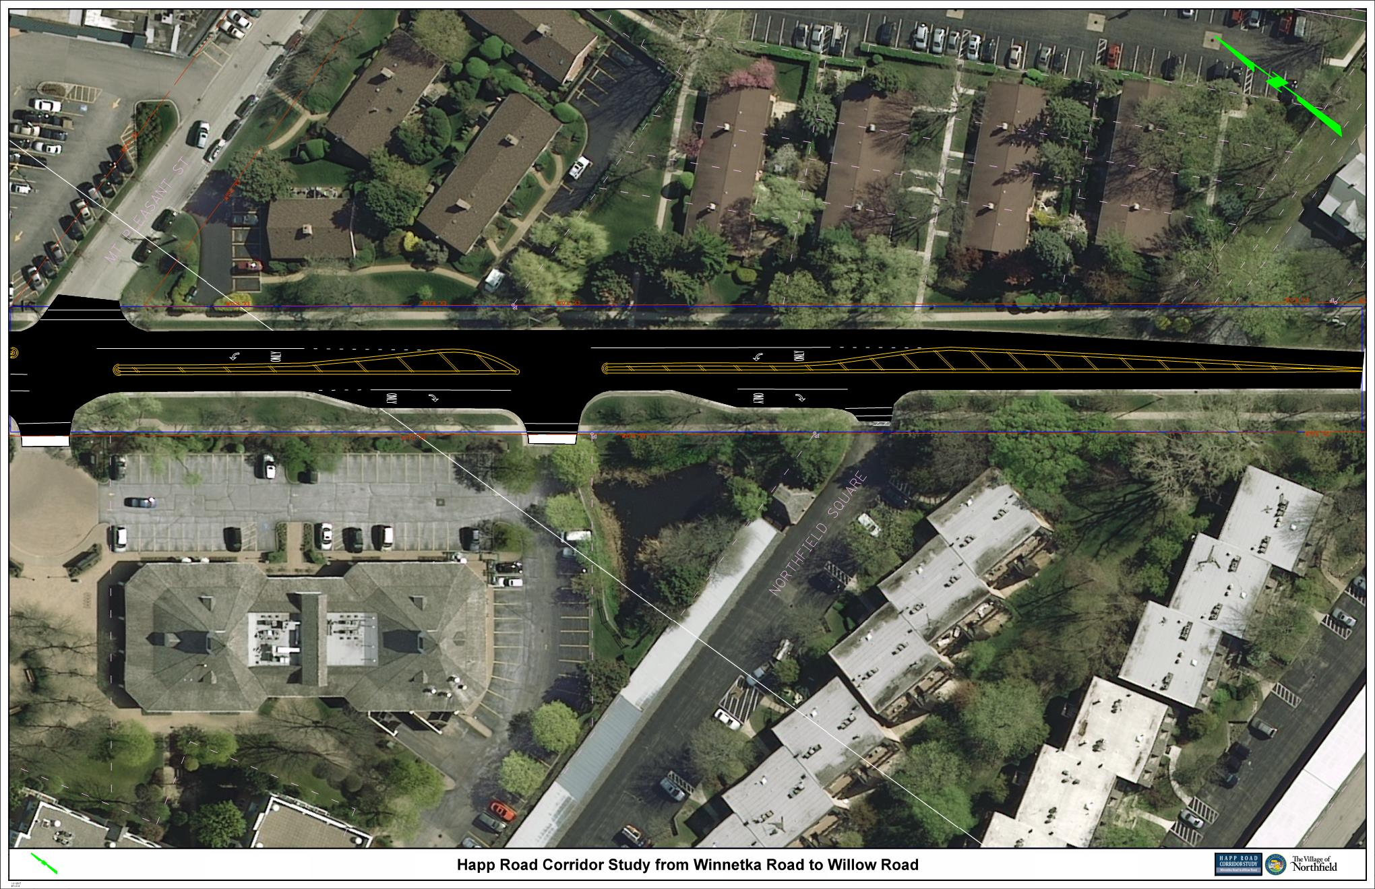
Existing Conditions
Mt. Pleasant Street

Slide 26
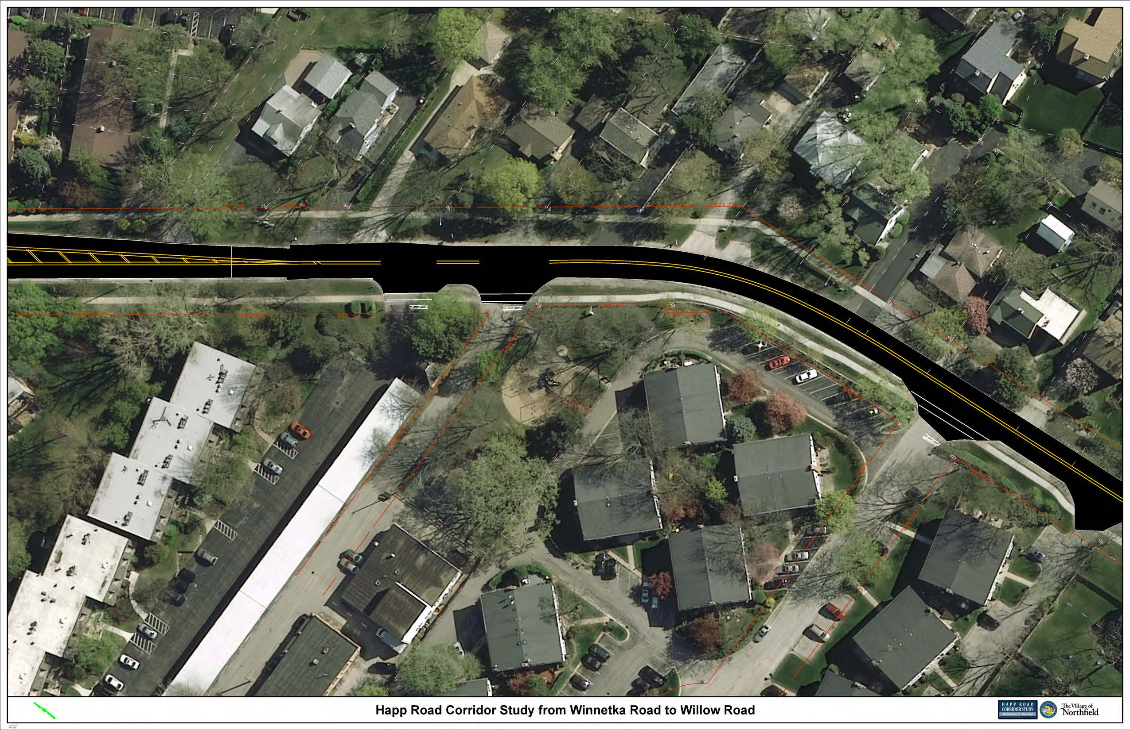
Existing Conditions – Park Area
Holder Lane
Colonial Lane

Slide 27
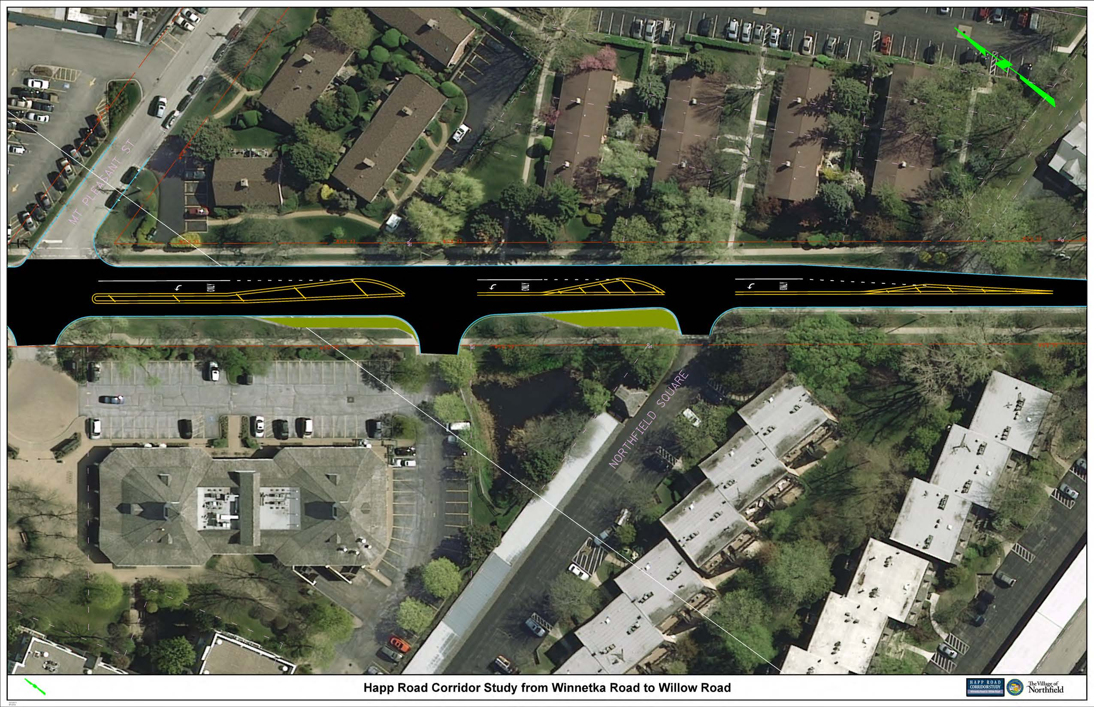
Happ Road – South of Downtown
Mt. Pleasant Street

Slide 28
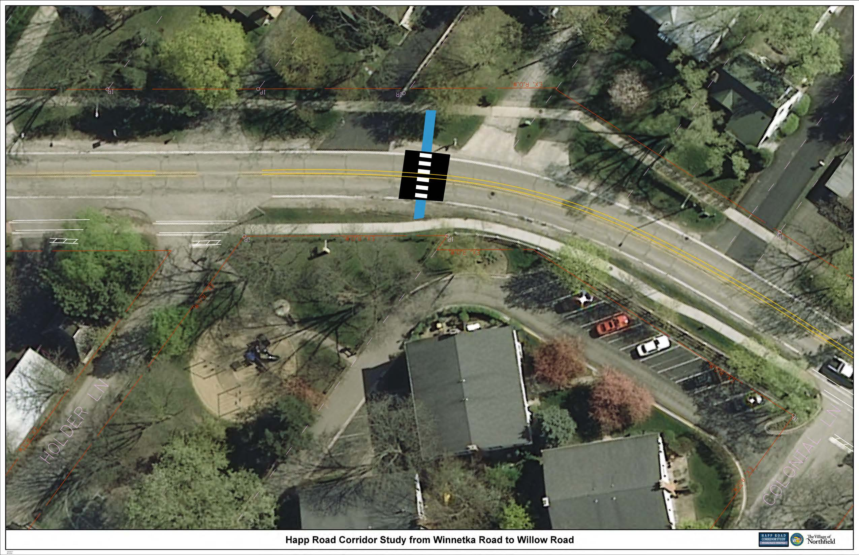
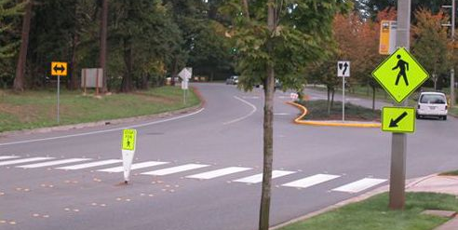
Happ Road Park
Mid-Block Pedestrian Crossing Alternatives
Without Refuge Island
Notes:
Beginning with Initial Round 1 Activities
Part 1: Identify issues and concerns
Part 2: Defining goals and objectives

Slide 29
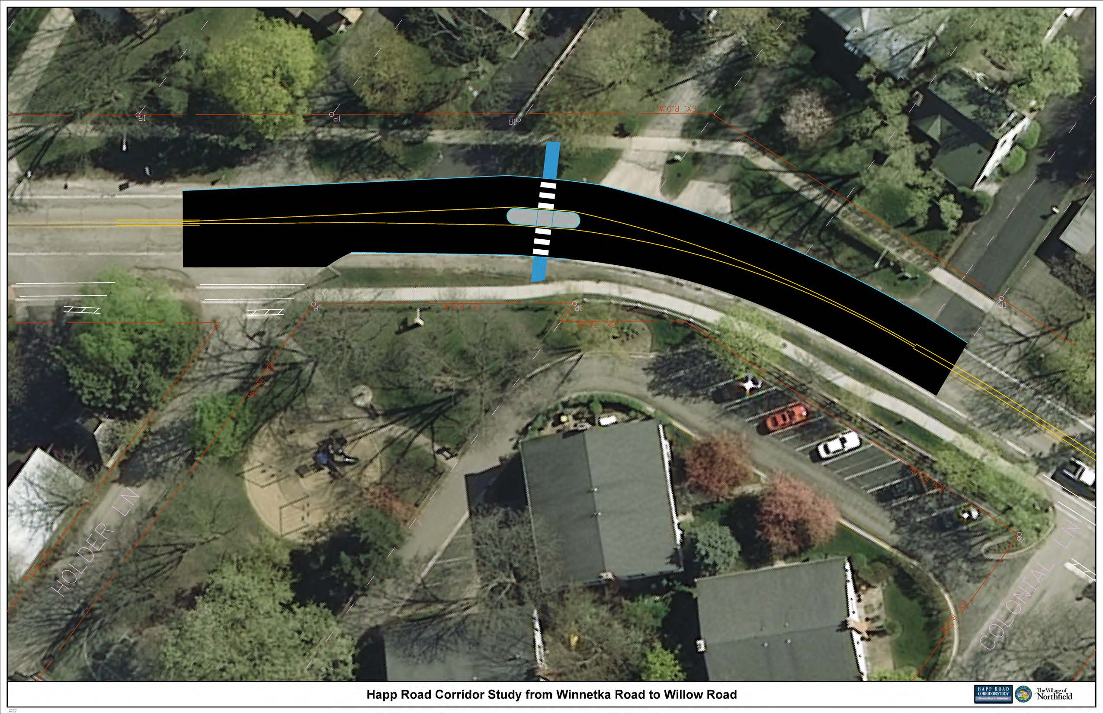
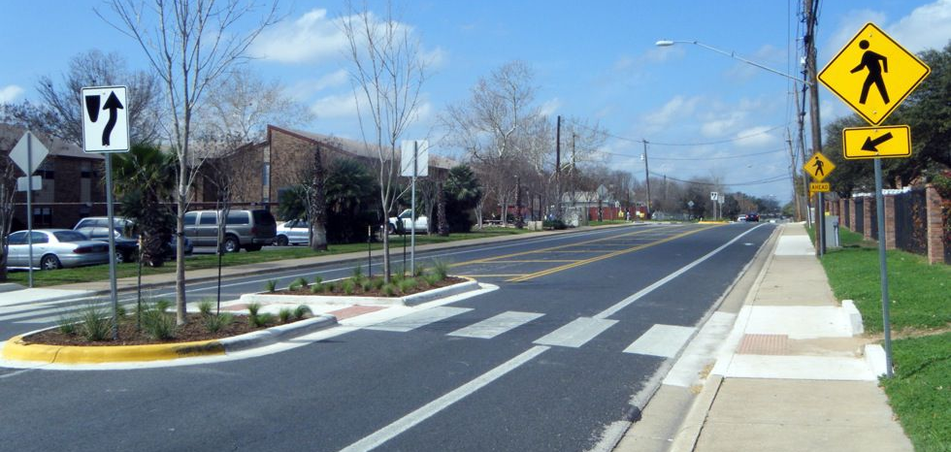
Happ Road Park
Mid-Block Pedestrian Crossing Alternatives
With Refuge Island
Notes:
Beginning with Initial Round 1 Activities
Part 1: Identify issues and concerns
Part 2: Defining goals and objectives

Slide 30
South Section
(Winnetka Intersection)
Happ Road Phase I Study
Village of Northfield

Slide 31
Accident Location Map

Slide 32
Accident Analysis
Winnetka Road Intersection:
Angle 13
Rear-end 10
Turning 1
Sideswipe 1
TOTAL: 25
High incidence of Angle Crashes indicates confusion or lack of sight distance for movements among adjacent intersection legs.
High incidence of Rear-End Crashes indicates stop and go congestion on some intersection legs
Low Turning and Sideswipe Crashes is expected at fully stop controlled intersections

Slide 33
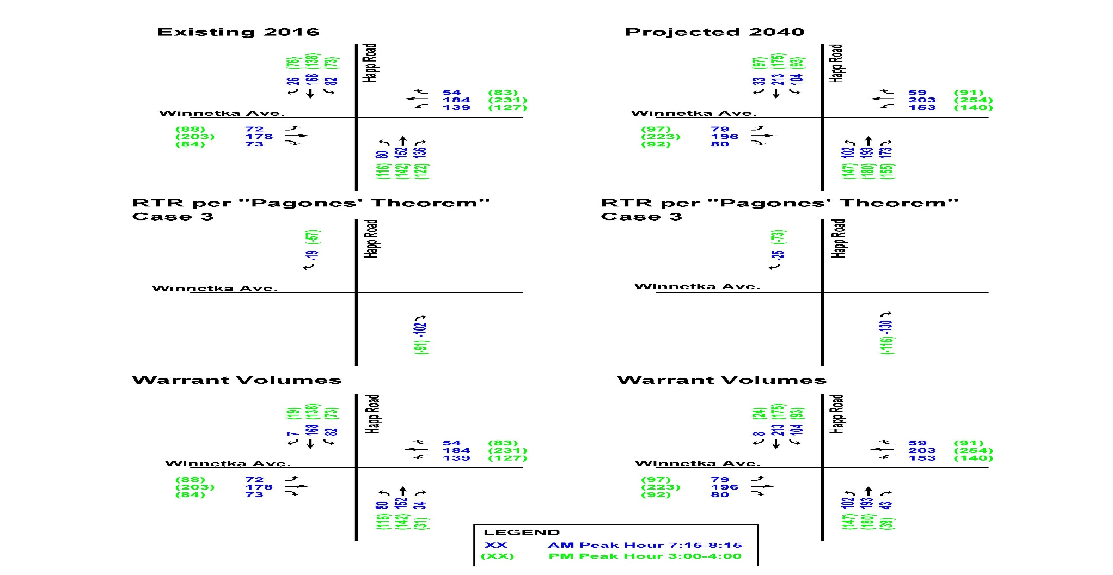
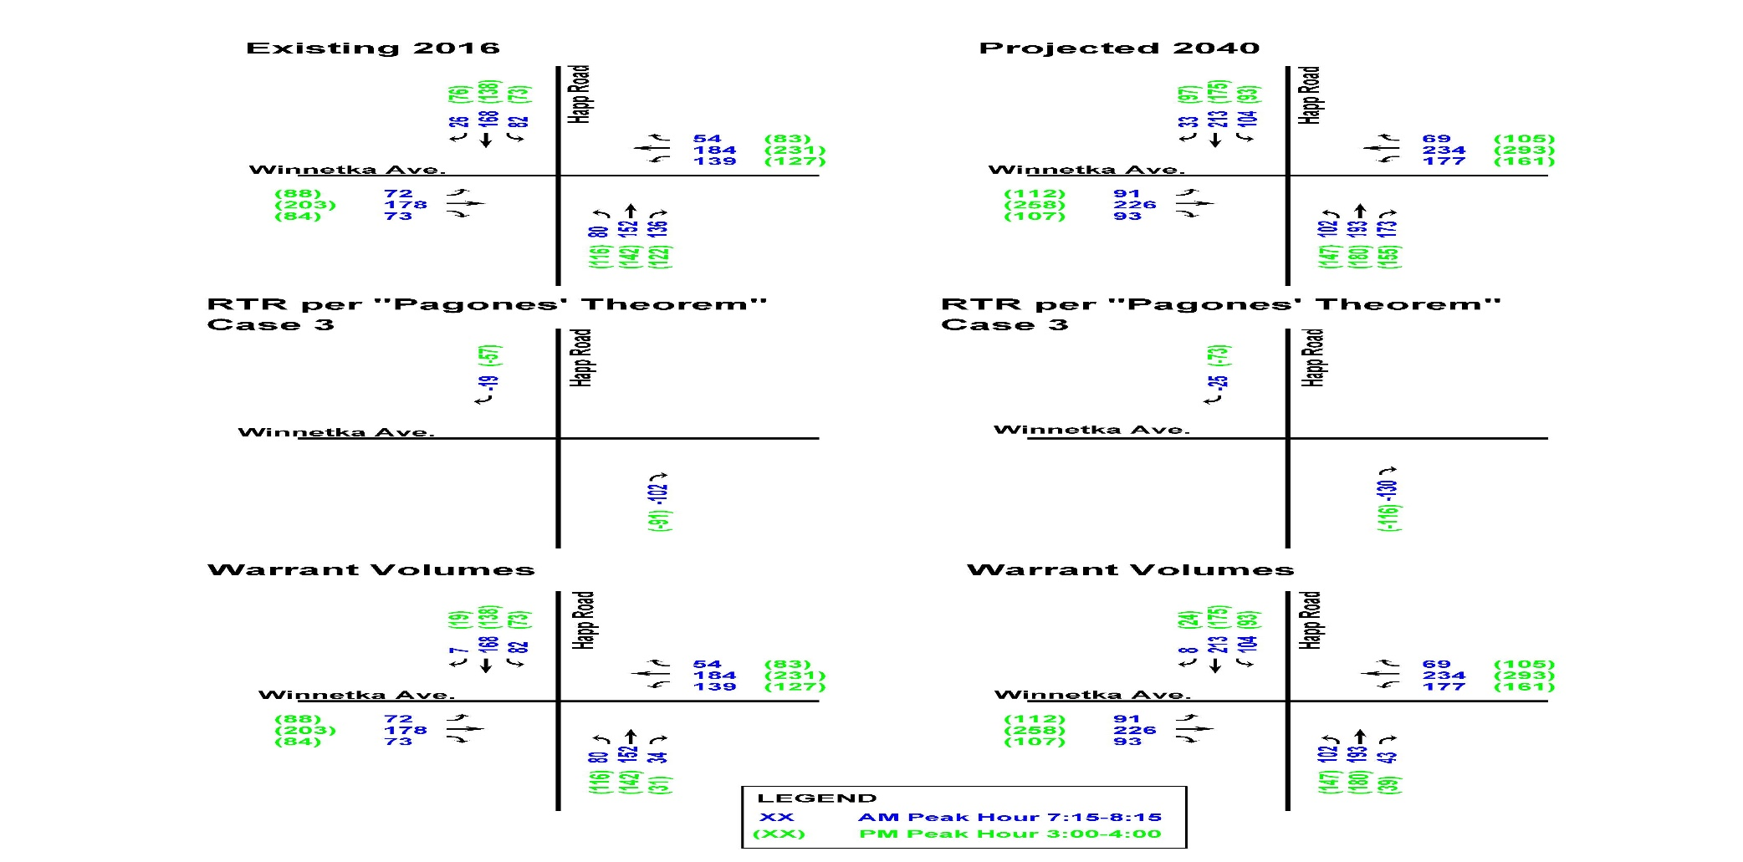
Traffic Data
Happ Road at Winnetka Road Intersection:

Slide 34
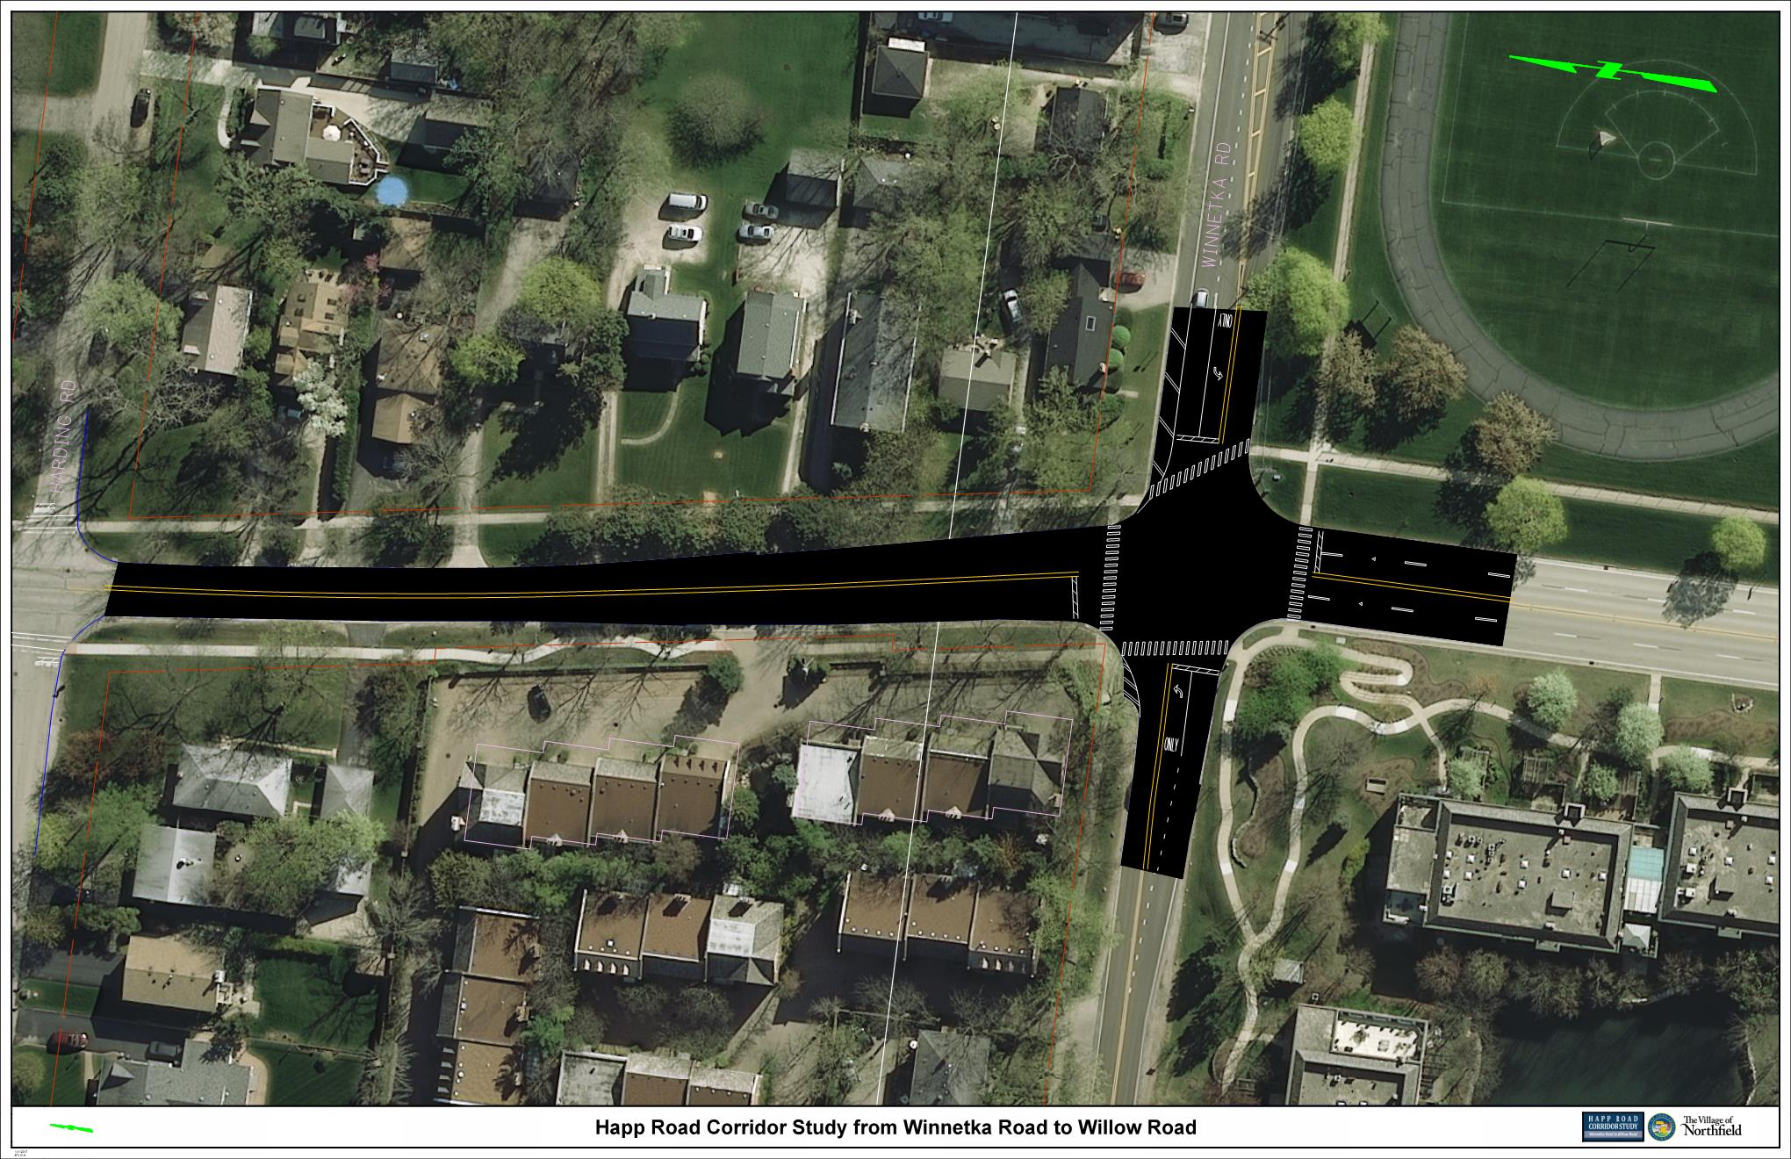
Existing Conditions – Winnetka Road
2016 Traffic Analysis
AM LOS - C (EB) / C (WB) / B (NB) / B (SB)
PM LOS - C (EB) / C (WB) / C (NB) / B (SB)
Winnetka Road
Happ Road
2040 Traffic Analysis
AM LOS - C (EB) / C (WB) / C (NB) / B (SB)
PM LOS - C (EB) / D (WB) / C (NB) / A (SB)

Slide 35
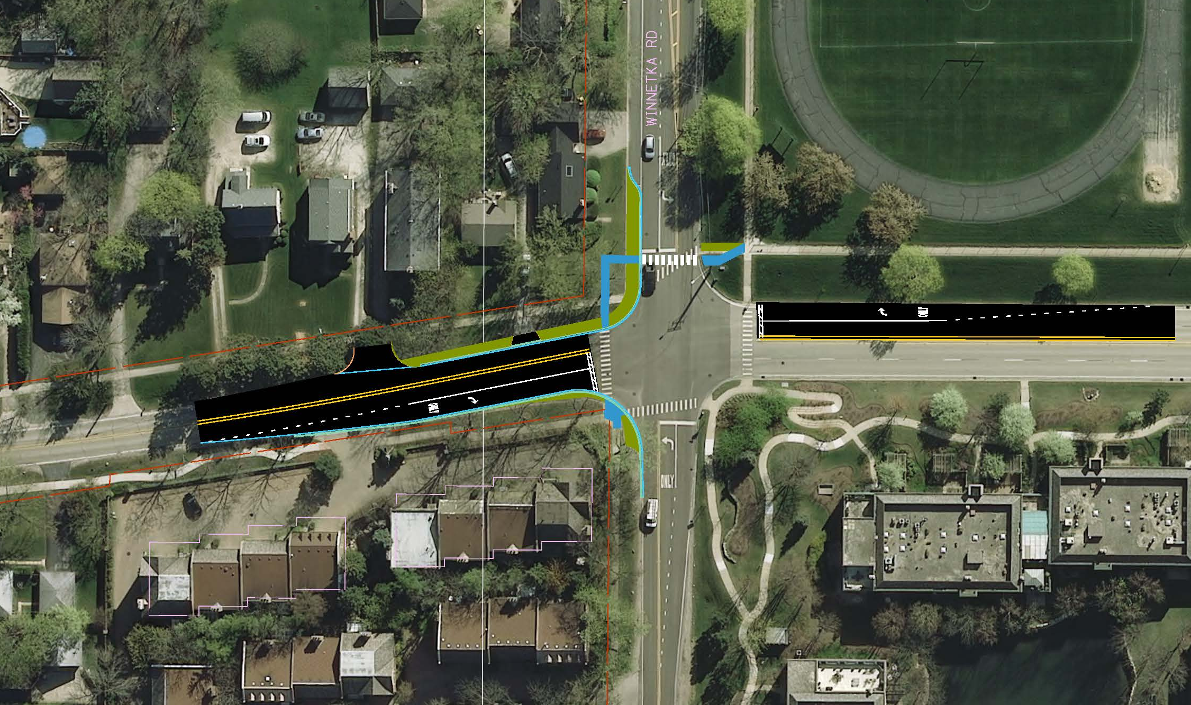
Happ Road – Winnetka Road Intersection
Alternative – 4-way Stop (SB & NB Right Turn Lanes)
2016 Traffic Analysis
AM LOS - C (EB) / C (WB) / C (NB) / C (SB)
PM LOS - C (EB) / C (WB) / C (NB) / C (SB)
2040 Traffic Analysis
AM LOS - C (EB) / C (WB) / C (NB) / D (SB)
PM LOS - D (EB) / D (WB) / D (NB) / D (SB)
Notes:
Beginning with Initial Round 1 Activities
Part 1: Identify issues and concerns
Part 2: Defining goals and objectives

Slide 36
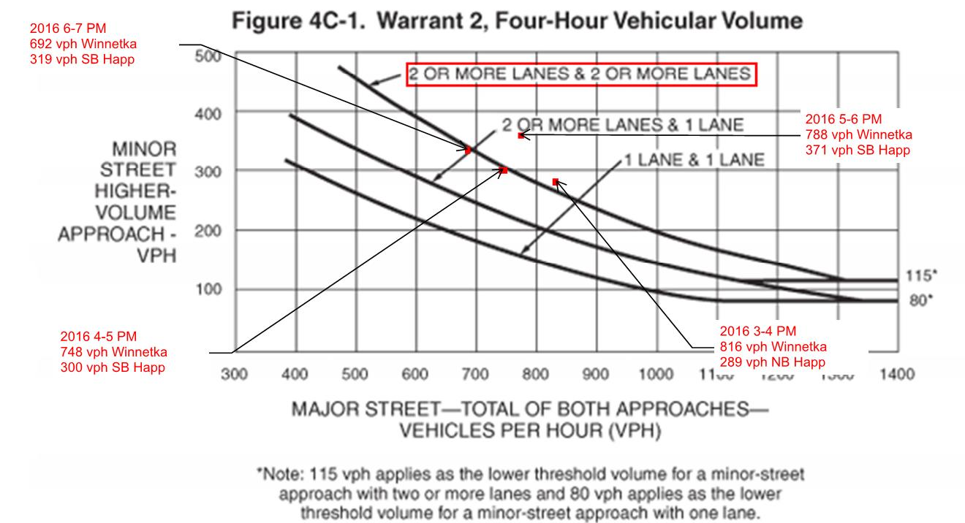
Signal Warrant - Right Turn Only Lanes
Manual on Uniform Traffic Control Devices (MUTCD) 2009 Edition Chapter 4C: Warrant 2, Four-Hour Vehicular Volume

Slide 37
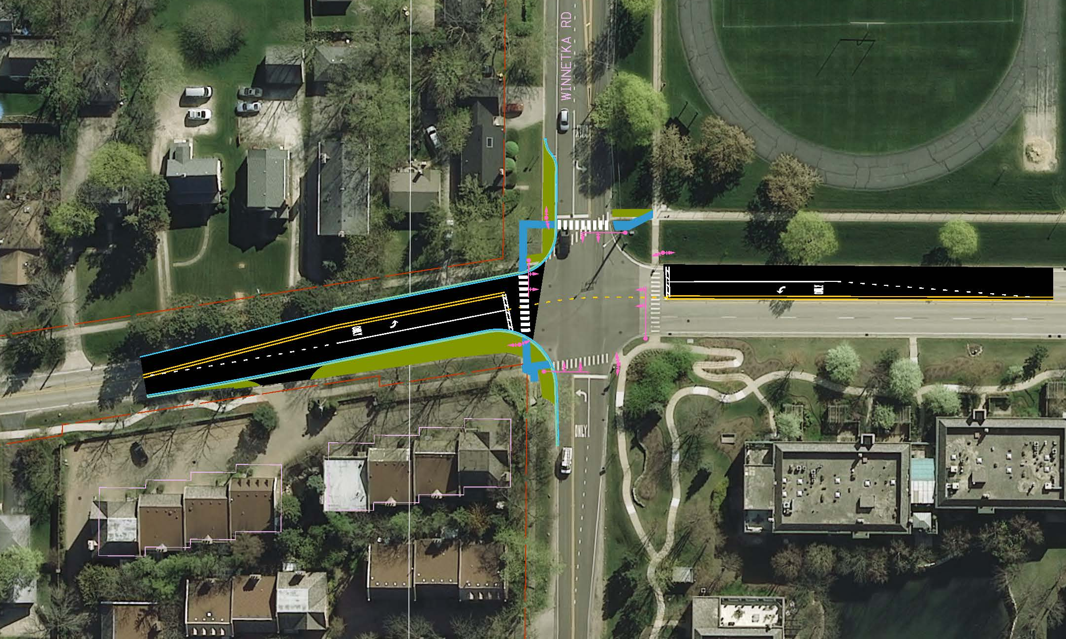
Happ Road – Winnetka Road Intersection
Alternative – Signal (SB & NB Left Turn-only Lanes)
2016 Traffic Analysis
AM LOS - B (EB) / B (WB) / C (NB) / C (SB)
PM LOS - B (EB) / B (WB) / C (NB) / C (SB)
2040 Traffic Analysis
AM LOS - C (EB) / C (WB) / C (NB) / C (SB)
PM LOS - C (EB) / C (WB) / C (NB) / C (SB)
Notes:
Beginning with Initial Round 1 Activities
Part 1: Identify issues and concerns
Part 2: Defining goals and objectives

Slide 38
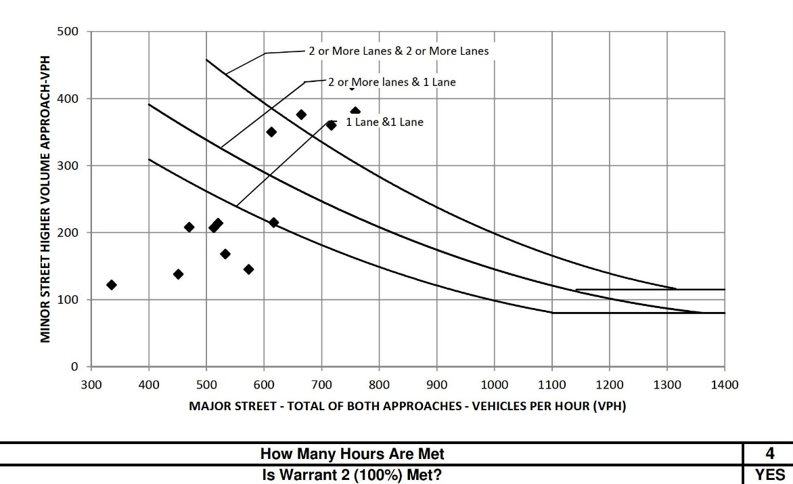
Signal Warrant – Left Turn Only Lanes
Manual on Uniform Traffic Control Devices (MUTCD) 2009 Edition Chapter 4C: Warrant 2, Four-Hour Vehicular Volume

Slide 39
Summary of Alternatives
Alternatives | Pros | Cons
4-Way Stop Control | Maintains existing roadway alignment | Maintain driver uncertainty of who is going and if vehicles are turning
 | Utilizing existing roadway pavement | Maintains unsafe pedestrian crossing condition
Traffic Signal | Improves LOS for all legs of the intersection | Increases delays at off-peak time
 | Facilitates pedestrian crossing movements in all directions
 | Relocates Sidewalk to within the ROW

Slide 40
Next Steps
Public Meeting
    Northfield Community Center (401 Wagner Road)
    Present Alternatives
    Solicit Public Input
Consider Public Input
Refine Alternatives
IDOT Coordination
Select a Preferred Alternative
Present at Second Public Meeting

Slide 41
Thank you for participating!
See you next time.
If you have any questions in the interim, please contact
Stacy Sigman (ssigman@northfieldil.org)
at the Village of Northfield
Steve Lynch (slynch@patrickco.com)
at Patrick Engineering
www.HappRoadStudy.com

